Slide 1
Goods Receipt Premier
16/11/2020

Slide 2
Baseline | Manufacturing, shipment, & delivery to warehouse
Manufacturing, Shipment, & Initial Delivery to Warehouse [KNK ERP, Saarus ERP, off system]
Saarus Team manufactures & QCs new Cooker Kits
Saarus Team scans serials on newly ready Cooker kits to add to Product Tracker
Saarus Team creates Delivery Orders for kits scheduled for shipment to Kenya
Kenya ERP automatically creates a PO, which must be approved to receive units in Kenya warehouse
Warehouse Manager scans each kit received at Premier & reconciles any not captured on PO with Saarus team
Kenya ERP automatically adds newly received kits to Inbound location at Premier MSW
Cooker Kit travels from India to Kenya, clears customs, and transits from ICD to Premier warehouse [currently tracked manually via Dispatch Tracker]

Slide 3
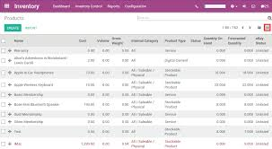
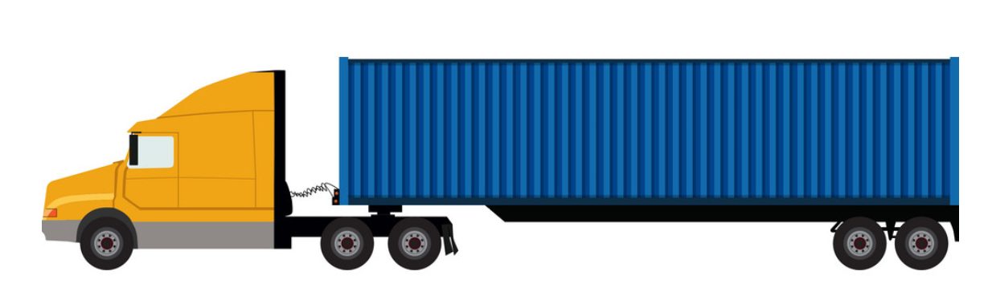
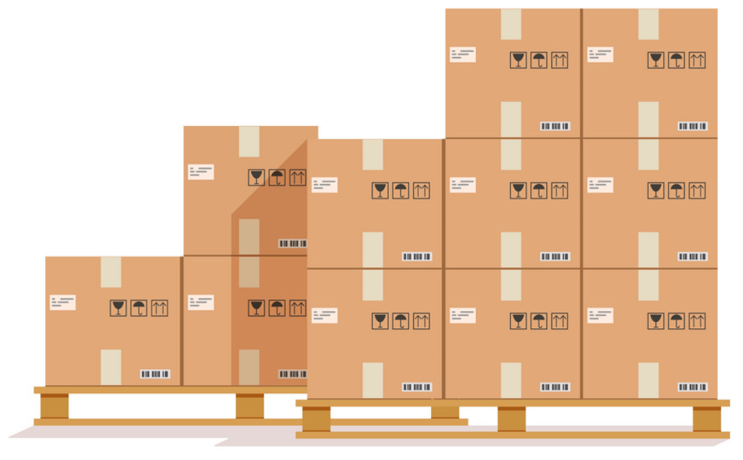
Overview of the receipt process
Friday 13th
3
1
2
3
Monday 16th - Tuesday 17th
Monday 16th
1 | Prep for receipt
2 | Manual offload for container
3 | Recording on system

Slide 4

Summary of Key Steps
 | Activity | Effort | Elapsed Time | Team Members | External Dependencies | Odoo Interaction?
1 | Prep for Receipt | 1 - 2 hours | 2 - 3 hours | 5 | Stove Deliveries Loaded | None
2 | Manual offload for container | 2 - 3 hours | 2 - 3 hours | 11 | None | None
3 | Recording on system | 4 - 6 hours | 2 - 5 days | 2 | Peter Mudoko | Yes
The offload that I observed was for a container with 1200 cookers and 240 canisters. There are typically 2 containers to be received against a purchase order.
Dump of all of the videos and photos from the day. ⇒ https://drive.google.com/drive/u/1/folders/1fIYS5WaCkxWG4WBVaf9GHABA8tv0MPII

Slide 5
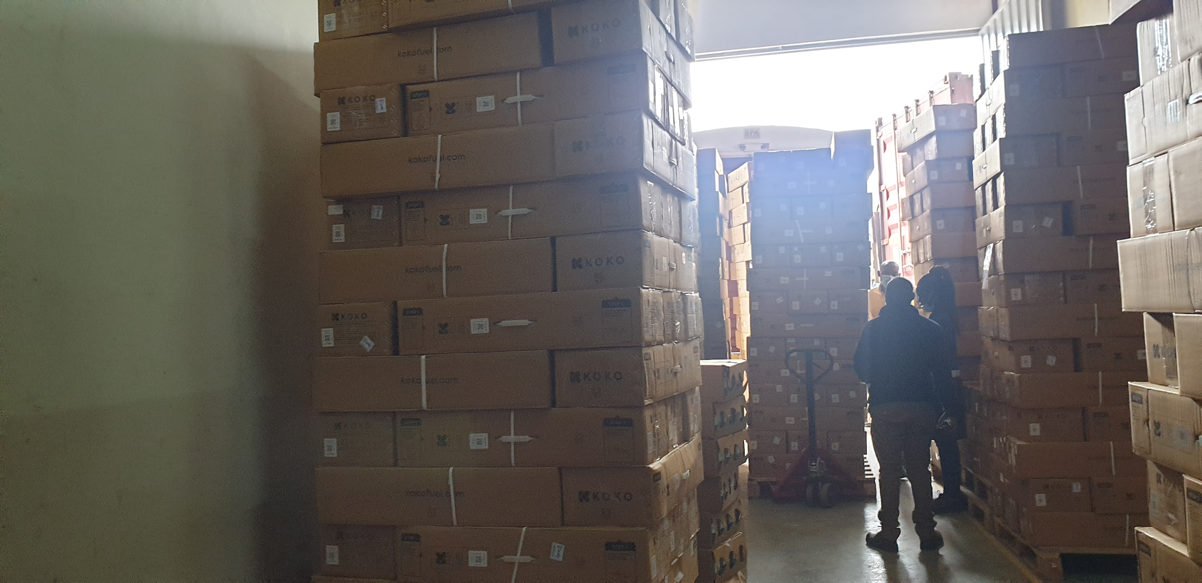
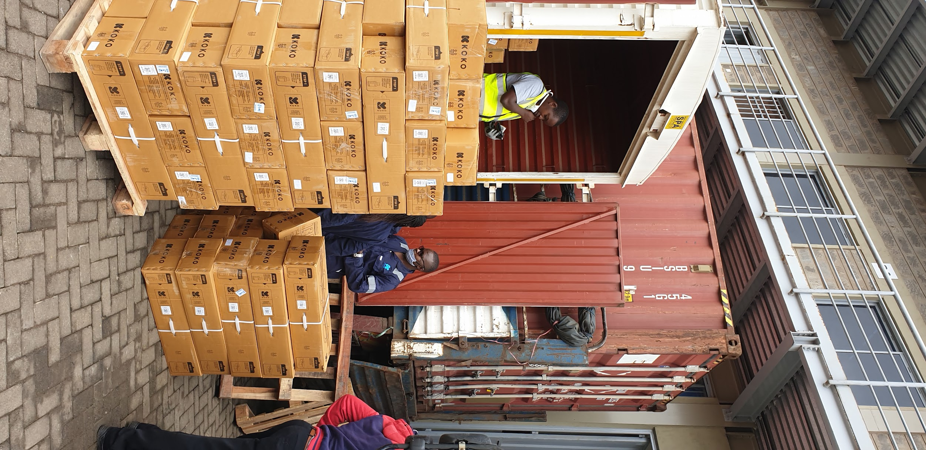
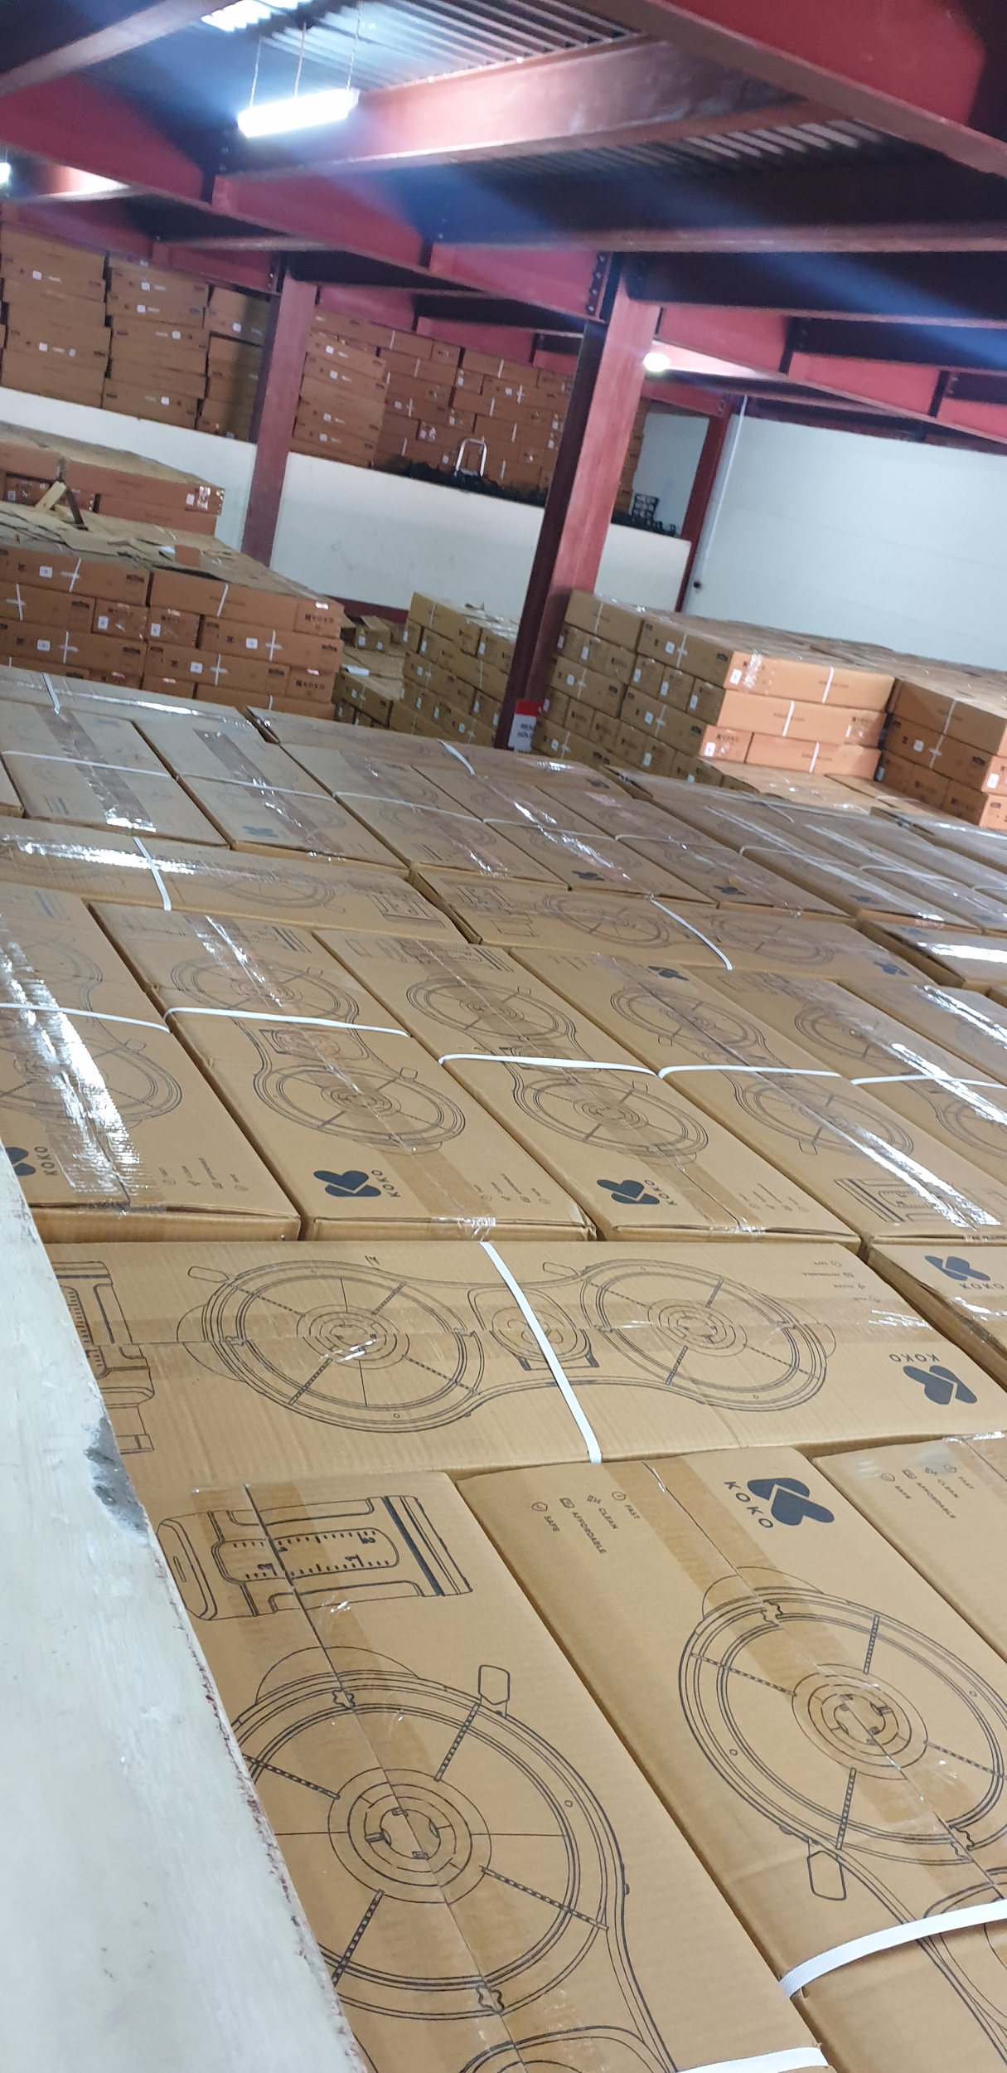
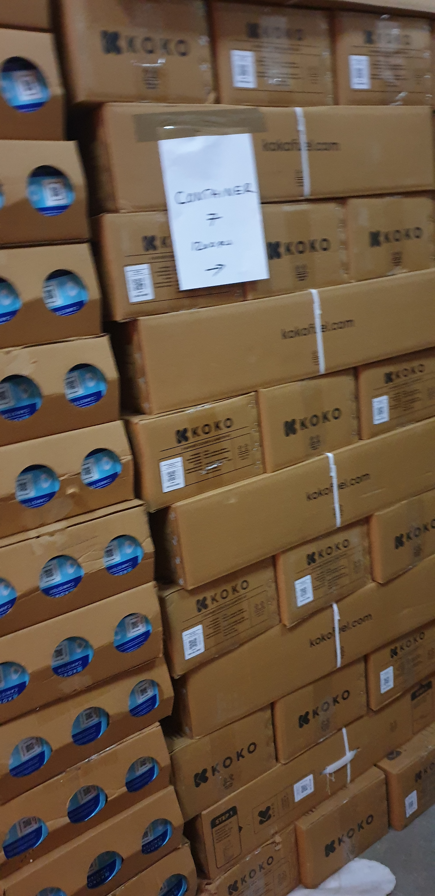
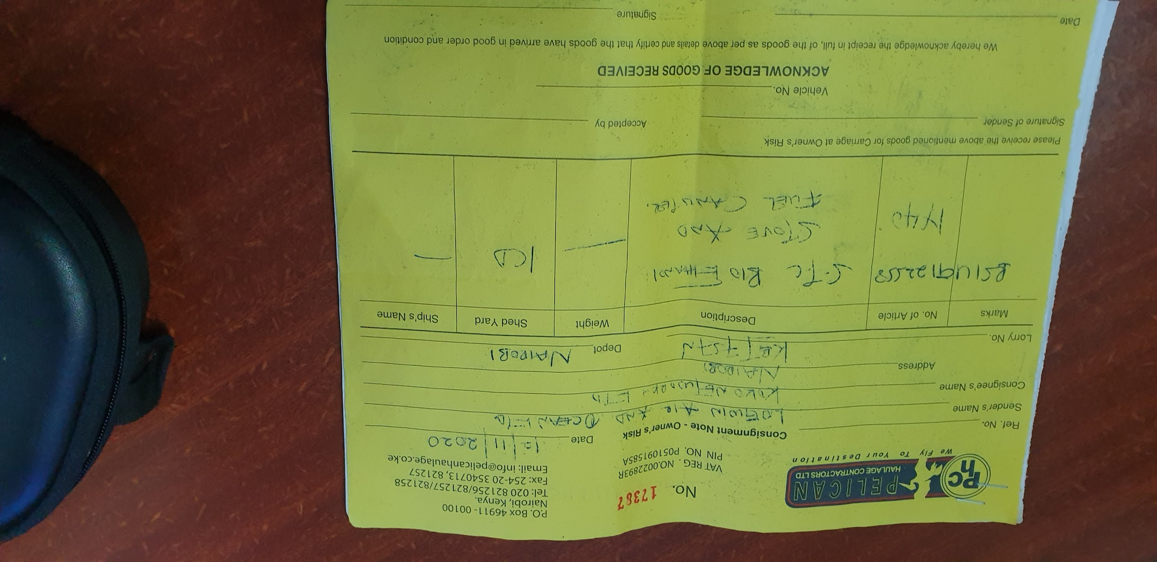
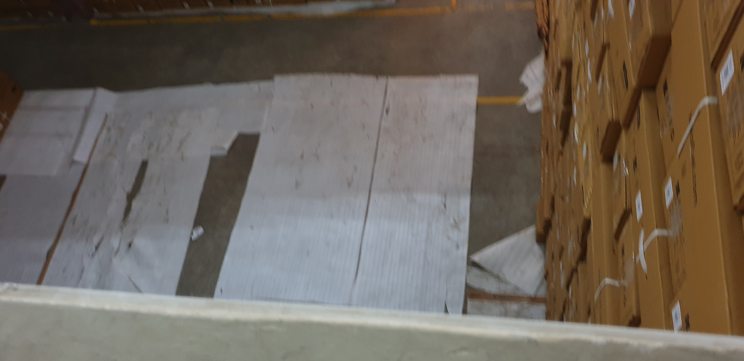
Prep for receipt
Truck with the container arrives at Premier (around 8 am), actual offload started at 10:15 am.
The space to offload into is designated. The warehouse is quite full, this space is between previous containers offloaded of differing ages. Container 9 was being offloaded and we were currently dispatching from container 5
There is only one entrance / exit at the warehouse so outbound activities have to be completed first
The trolley to move the pallets is the most important tool to be ready (it was)
The truck operator has a delivery note that he requires signed from, which he provides at the start.
Designated Area
Outbound Blocking
Delivery Note

Slide 6
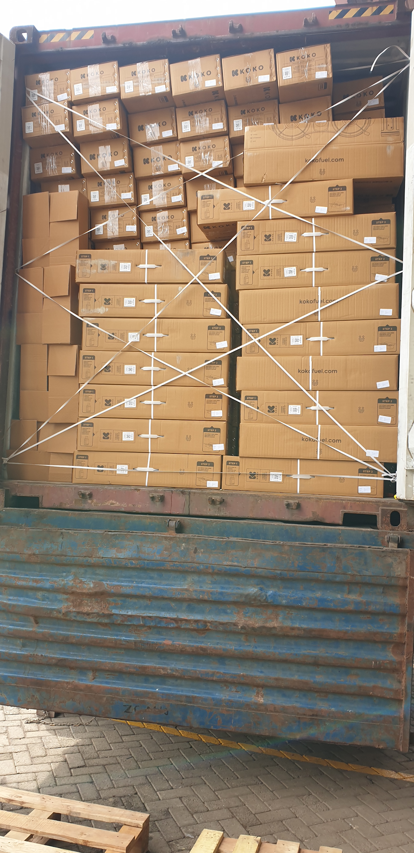
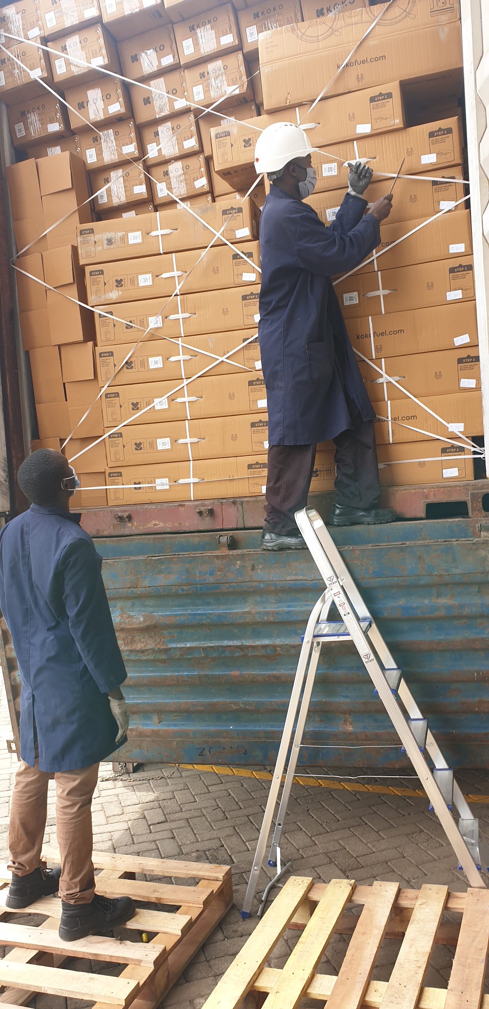
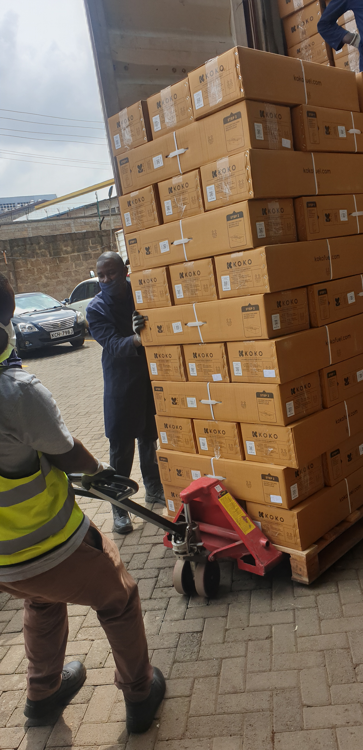
Manual Offload
Seal is broken on the container and the doors are opened.
The team cuts off the strapping that is holding back the cookers. There is very little space to work on and it looked like this had a higher risk of injury and damage to the cookers.
Offloading begins to the pallets
Pallets are stacked with 44 cookers each and using the trolley, the cookers are moved to the designated space.

Slide 7
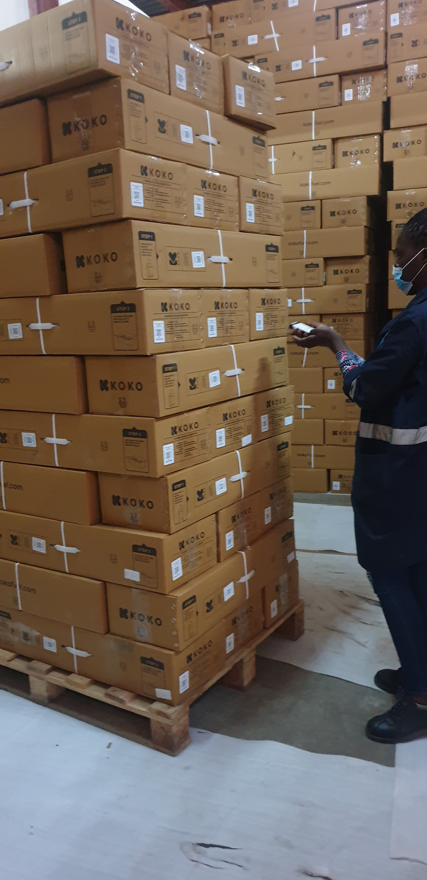
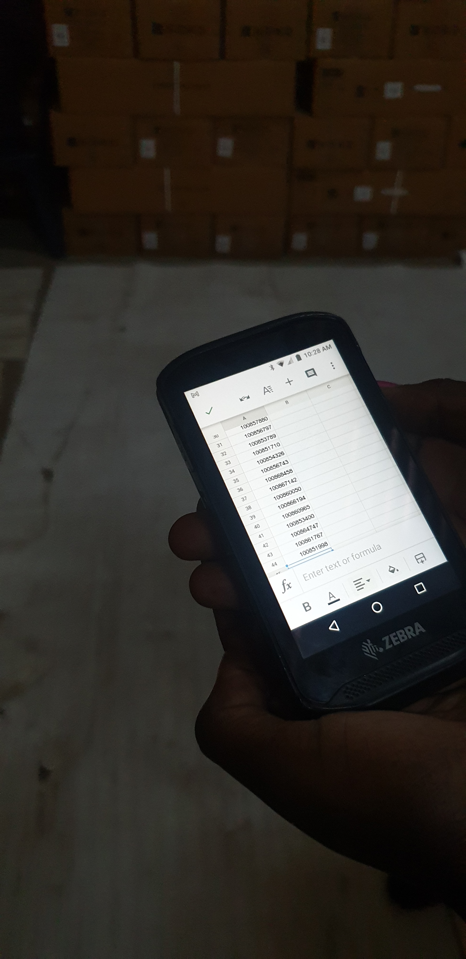
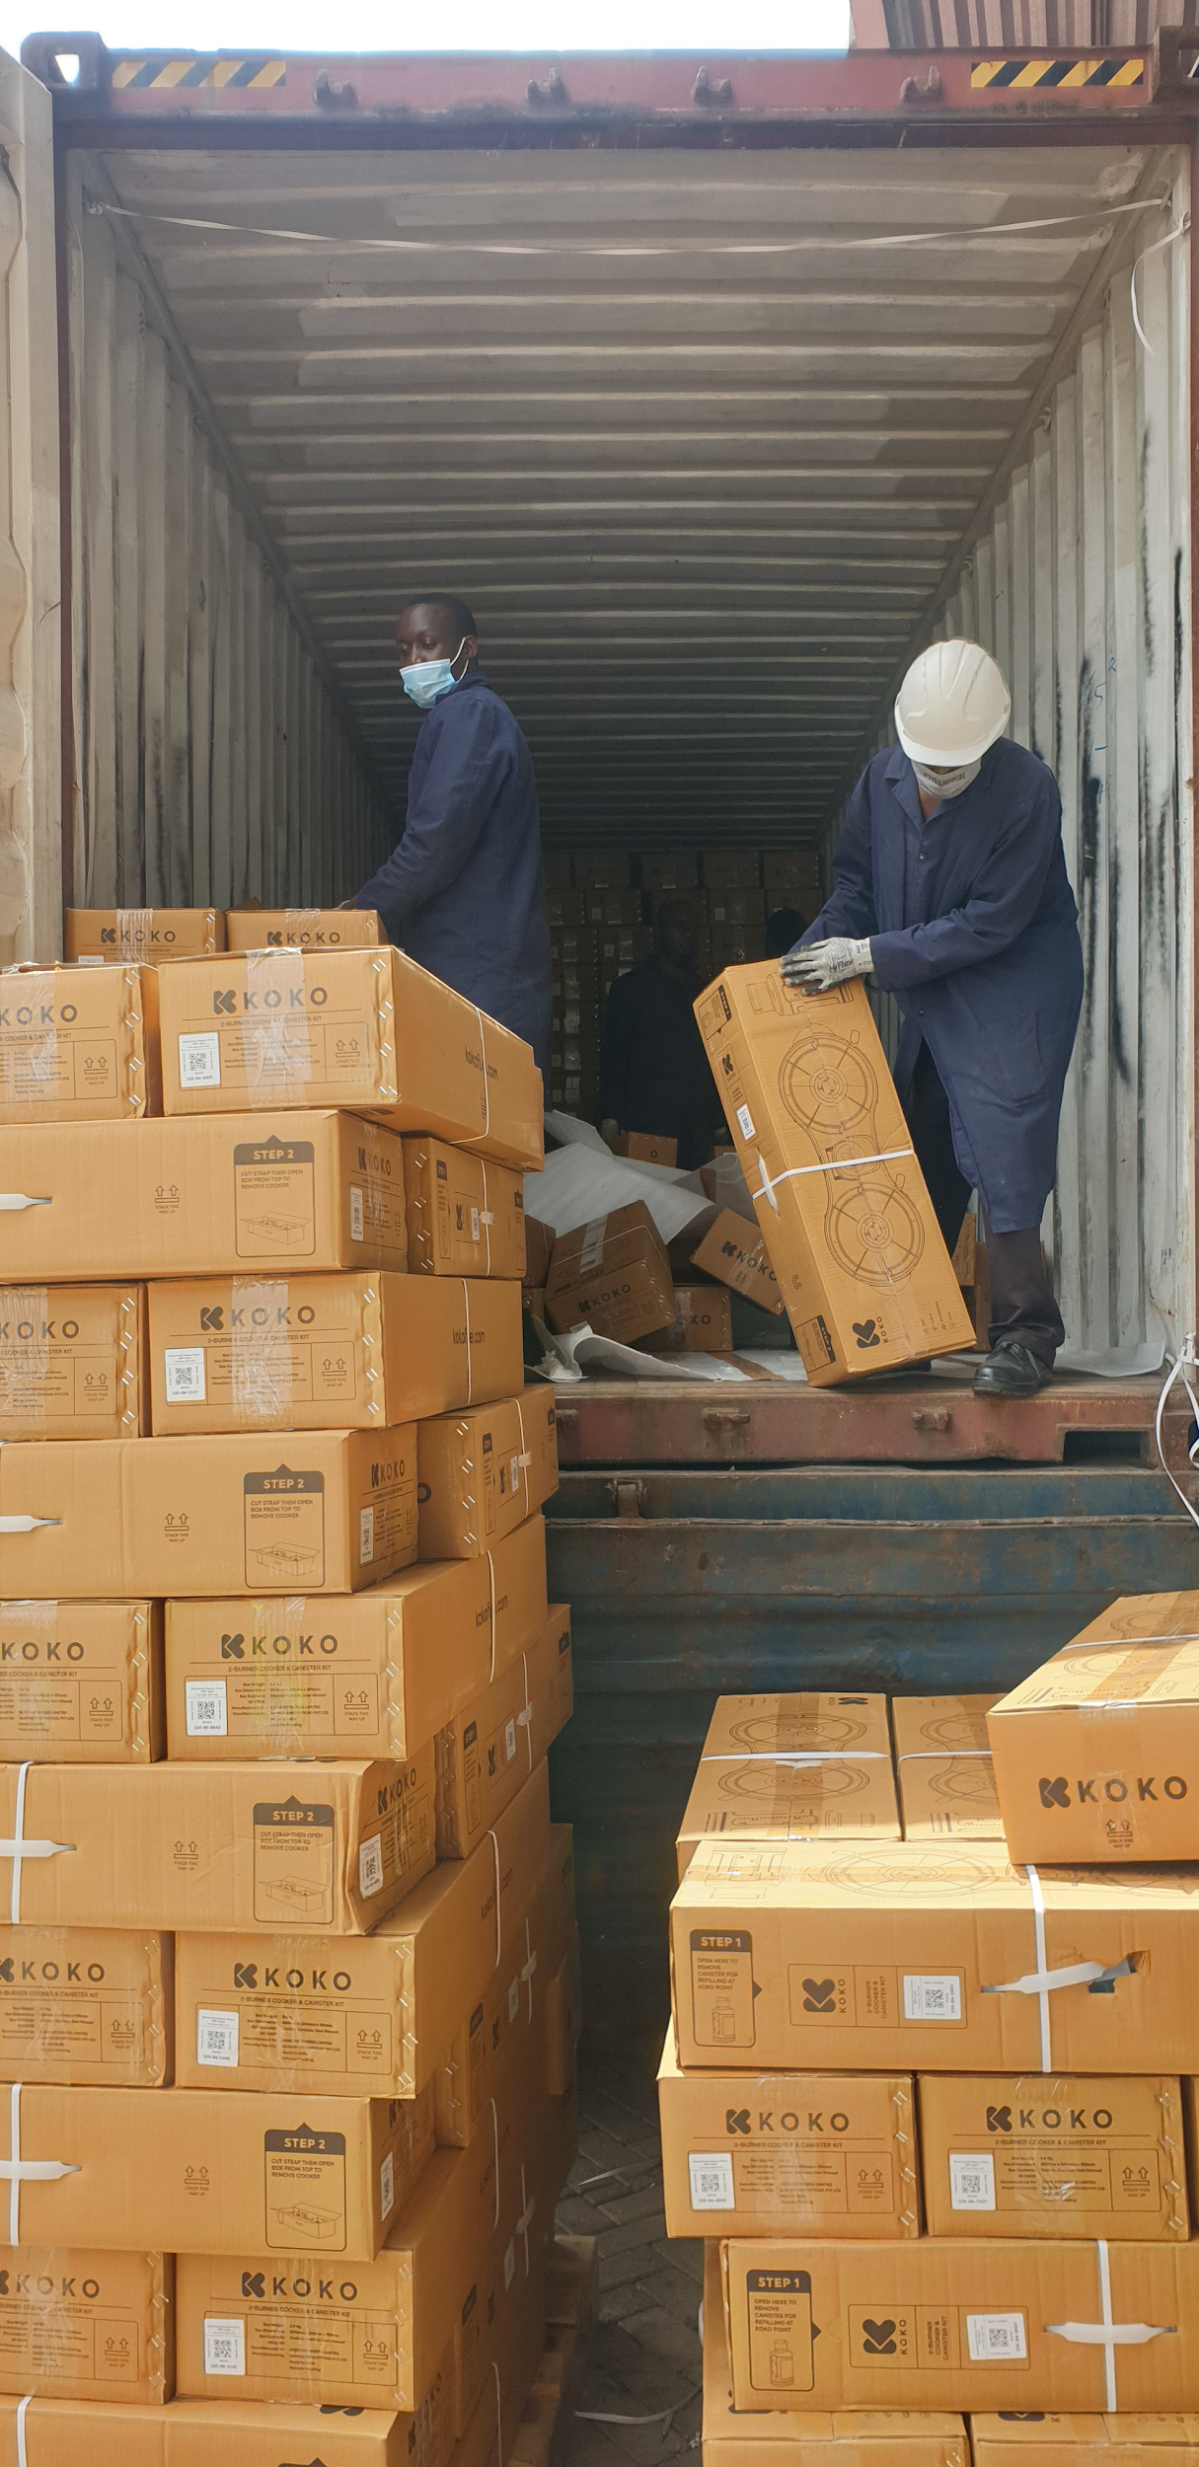
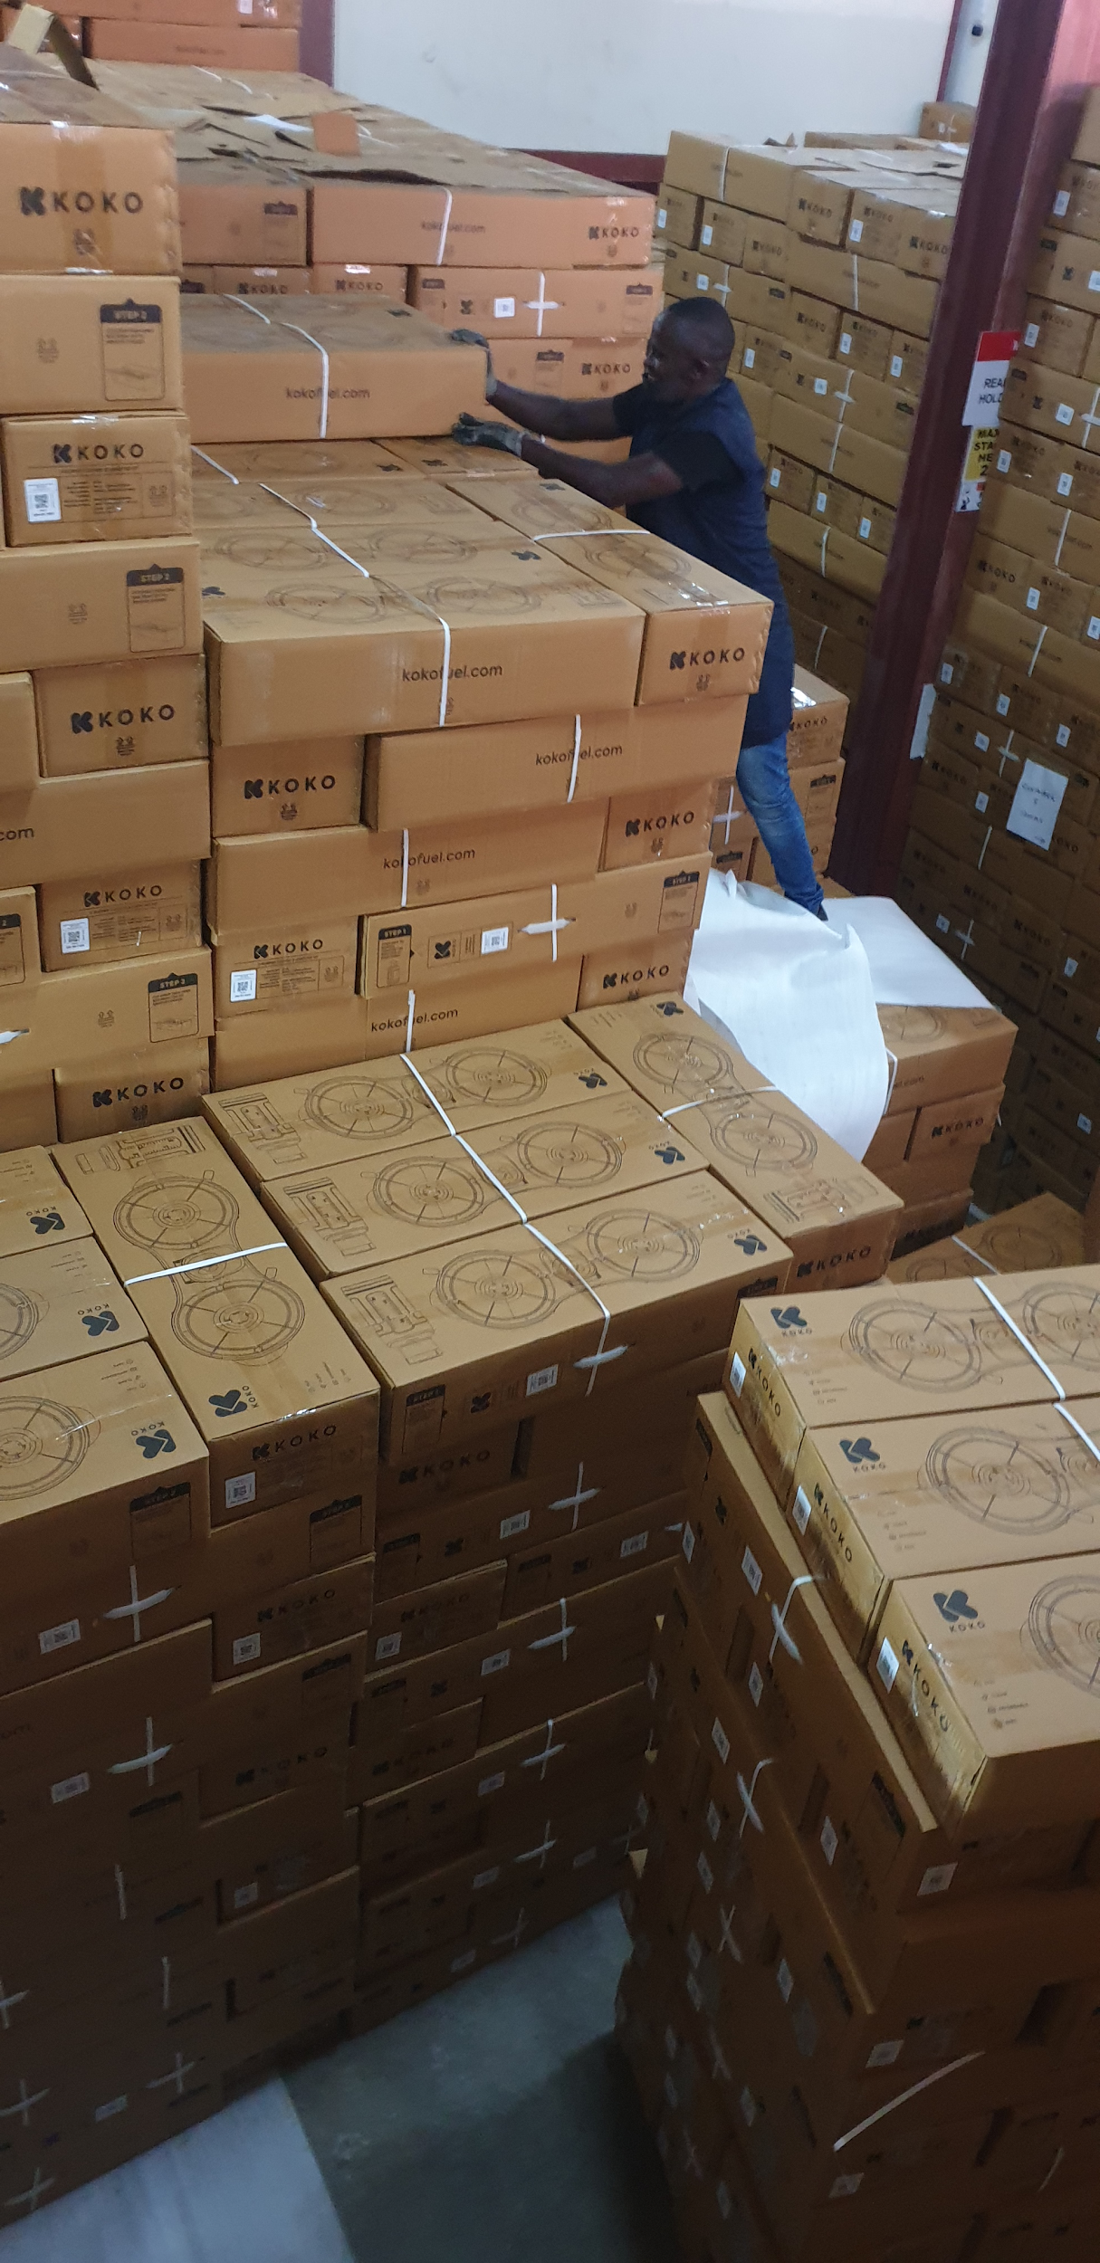
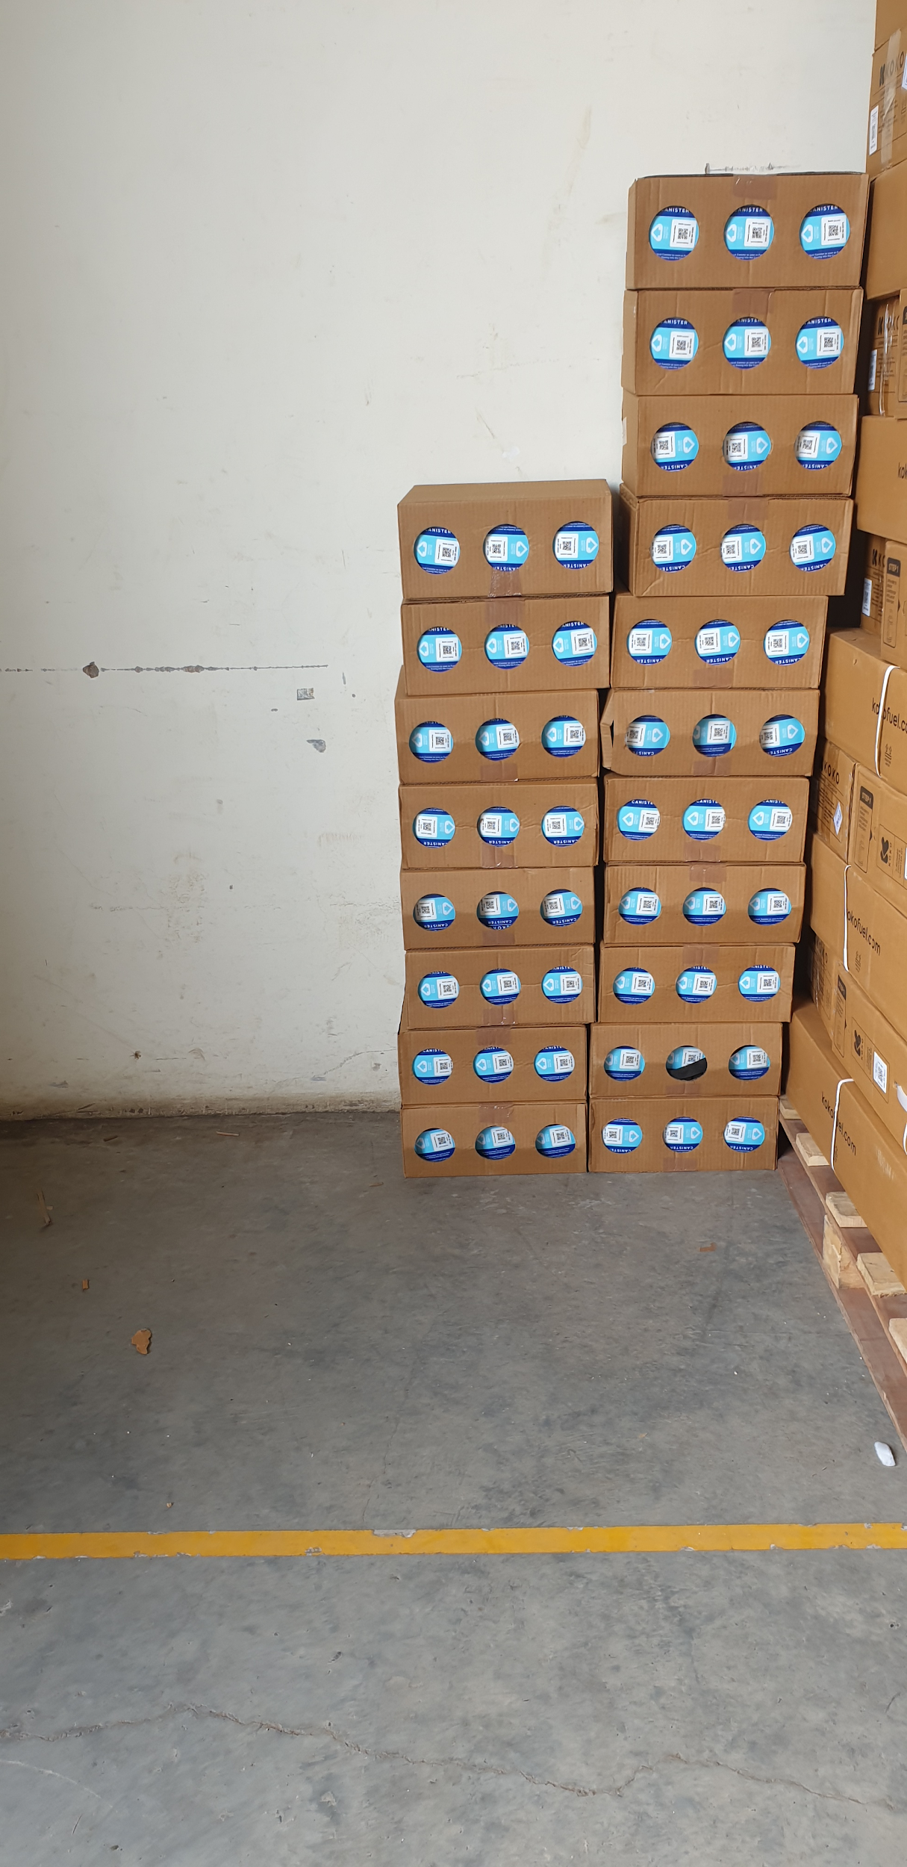
Manual Offload cont.
All of the cooker serials are then scanned into a Google Sheet by the Zebra Scanners. This took about 2 - 3 minutes for the 44 cookers.
The cookers were then stacked into the final offload area.
There were 11 team members involved in this and 1 person scanning the cookers into the Google Sheet.
There was a small interruption (around 15 minutes) for some additional outbound cookers that were dispatched
After all of the cookers were offloaded all the canisters were offloaded and scanned in a similar manner.
The manual offload started at 10:15 and ended at 12:55 pm

Slide 8
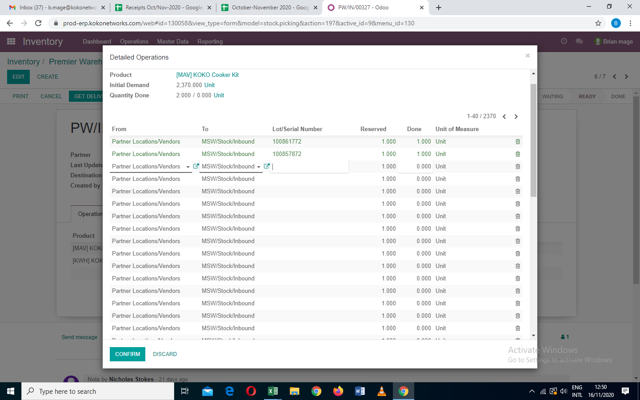
Recording on system
Cooker and canister serials were copied from the first Google sheet to the Receipts Oct/Nov 2020 Google Sheet.
This google sheet has the list of all of the receipts in October
The serial numbers have to be entered against the PO (copy pasted) 1 at a time for all of the serials in the Google sheet for the 2 containers!!
There was a dependence on Peter Mudoko all along the process for some unclear reasons to me. (Review his involvement in detail in the process)
Approval was done by the supervisor
This was completed 5 pm on Tuesday

Slide 9
Issues and Recommendations
 | Issue | Type | Tim’s Rank | Recommendation
1 | We have one entrance and so the process cannot start until the delivery trucks are loaded | Operational | Low
2 | The offloading of the first cookers presents high risk of injury and cooker damage as the offloader is teetering off the edge of the container | Operational | High | Get a platform that the team can stand on while offloading Shrink wrap the cookers with a pallet so that it is possible to use a trolley, manual forklift etc to offload
3 | Scanning of each serial being received, increases the offload requirement by 1 person | Operational and System | Medium | Have an aggregate serial that has all of the serials for the container being offloaded.
4 | Location being offloaded into was not originally meant to be an inbound stock location | Operational | Medium | This is obviously caused by the space constraints inside the facility, if we expect to continue to have the current stock levels at the warehouse then we should postpone any decisions on warehouse stock locations

Slide 10
Issues and Recommendations
 | Issue | Type | Tim’s Rank | Recommendation
5 | Offload of a container takes close to 3 hours | Operational | Low | Review the cost implications of keeping a container at around that time. I expect there are no additional charges if it is taking this long
6 | Manual restacking cookers within the warehouse | Operational | Medium | Get a bigger space if we expect to see containers at the current rate
7 | Copying serials between Google Sheets to be entered in the system | System | Top | Scan serials directly to a system (if necessary)
8 | Copying serials between Google Sheets to Odoo | System | Top | Receive all of the serials in bulk at once on the system without having to re enter them as an option. Scan serials directly to a system (if necessary). Bulk upload of serials from a file

